Slide 1

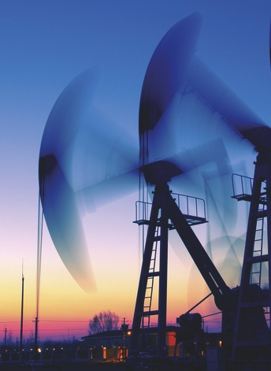


energy4me Activities
SPE Energy4Me Workshop

Slide 2

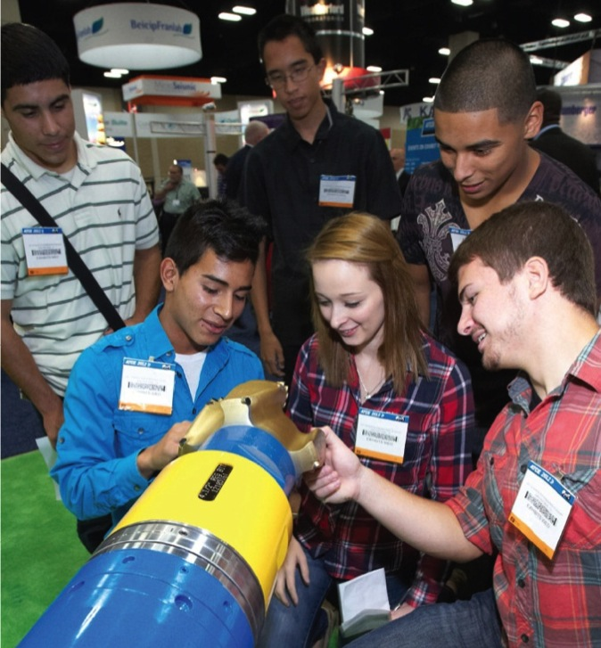
energy4me Activities
Energy4me Activities

Slide 3
Activity: Oil Seeps
Objective: Model the formation and process of natural oil seeps.

Slide 4
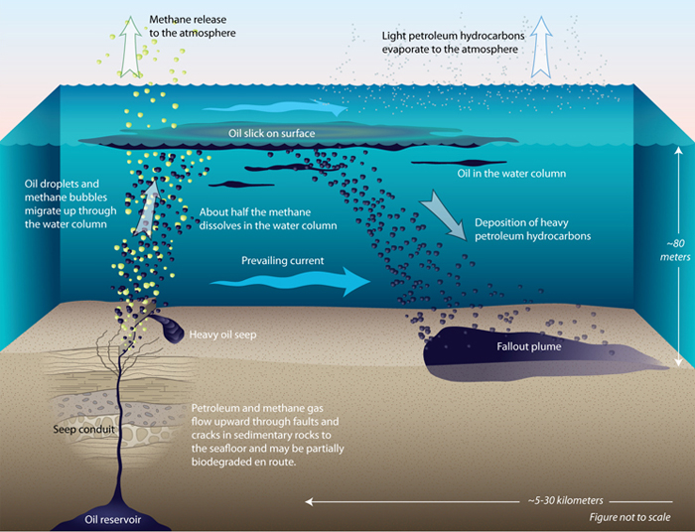
Activity: Oil Seeps
An oil seep is a place where natural liquid or gaseous hydrocarbons escape to the earth's atmosphere and surface, normally under low pressure or flow.
This helps scientists locate and identify potential “hotspots” that could develop into a productive well.

Slide 5
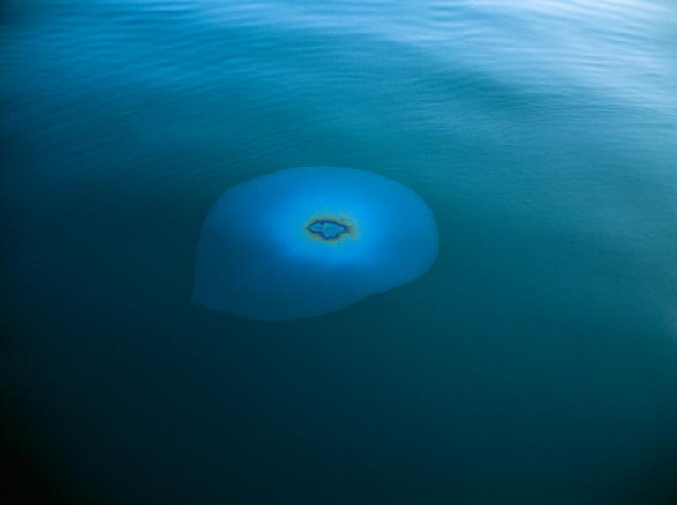
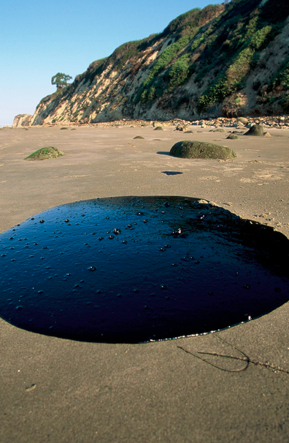
Activity: Oil Seeps

Slide 6

How Oil Is Produced
The Formation
Cap Rock
Gas
100 million barrels!
Oil
Water
Notes:
Attributions:
All original art

Slide 7
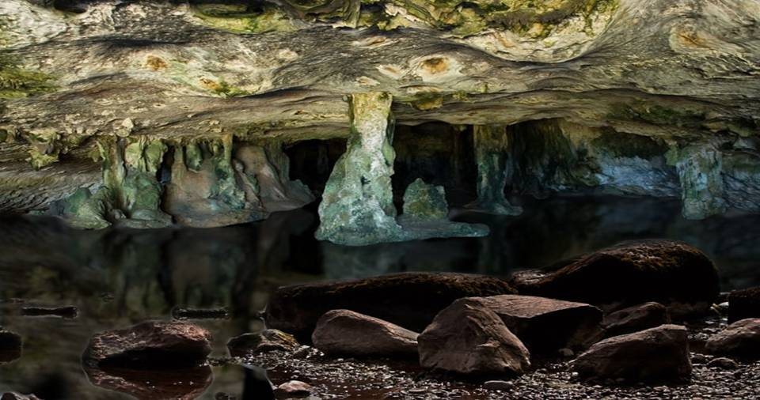
Where does Oil and Gas Come From?
(NOT FROM UNDERGROUND LAKES!)

Slide 8
Where does Oil and Gas Come From?
Oil drops in grains of sand
Gas
Oil
Water
Microscopic View
Source Rock (Fossils)

Slide 9
Formation Evaluation and Testing
What We Want to Know
Where is the oil and gas?
Latitude and longitude
Depth
How much is down there?
Reservoir size (area and thickness)
Porosity
Fluid type (oil, water, gas)
How difficult will it be to retrieve?
Pressure
Permeability
Viscosity
What quality of oil or gas is it?
How difficult or easy will it be to transport, process, and refine?
How will I manage this resource most effectively?
Notes:
Attributions:
Eduardo Sellan III. "Oil Reserves". Retrieved from https://commons.wikimedia.org/wiki/File:Oil_reserves.PNG on 08-Apr-2016. Licensed as Released by Author to Public Domain.
Schlumberger. "VBM 2.jpg". Retrieved from https://mediabank.slb.com/dam/dashboard on 17-Apr-2016. Licensed as Schlumberger.
Scott Bauer, USDA ARS. "Honey". Retrieved from https://commons.wikimedia.org/wiki/File:Runny_hunny.jpg on 08-Apr-2016. Licensed as Public Domain - Work by US Government.
Oil Well, Tea Kettle, Porosity, and Permeability are original art by author

Slide 10

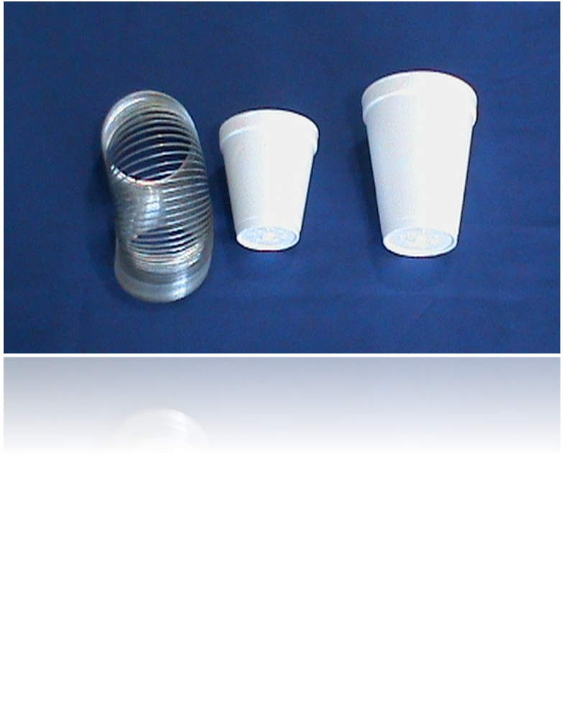
Activity: Sound Waves
Objective: Understand how scientists use seismic technology to locate geologic formations underground.

Slide 11
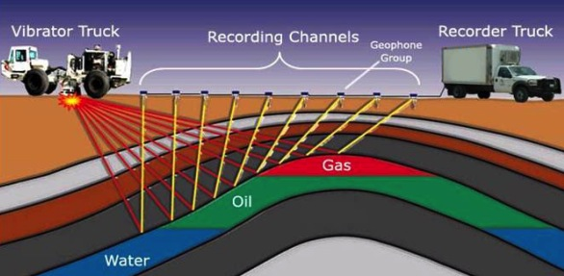
Activity: Sound Waves
Seismic surveying is a vital part of exploring for oil and gas. Oil and gas explorers use seismic surveys to produce detailed images of the various rock types and their location beneath the Earth's surface and they use this information to determine the location and size of oil and gas reservoirs.
Sound waves are bounced off underground rock formations and the waves that reflect back to the surface are captured by recording sensors.

Slide 12
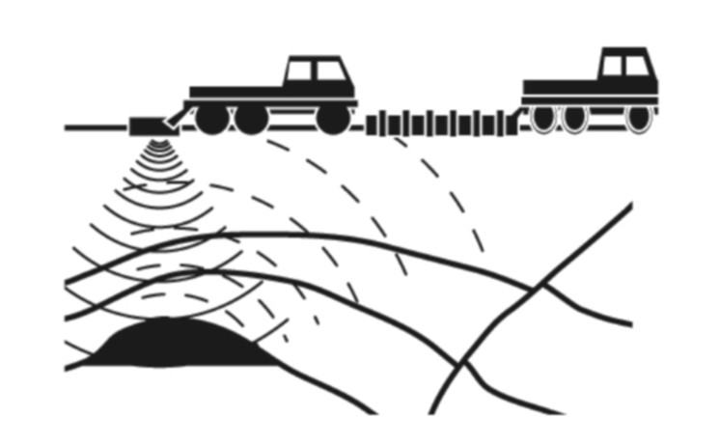
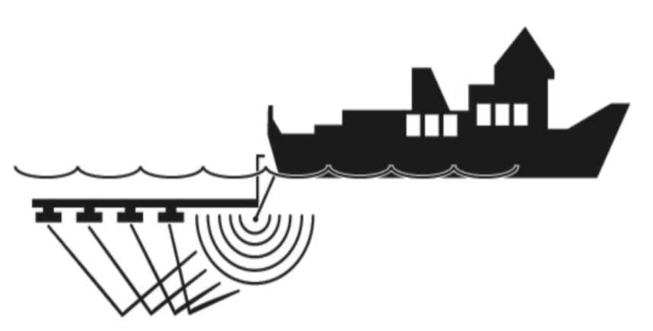
Seismic Technology
Land
Water

Slide 13
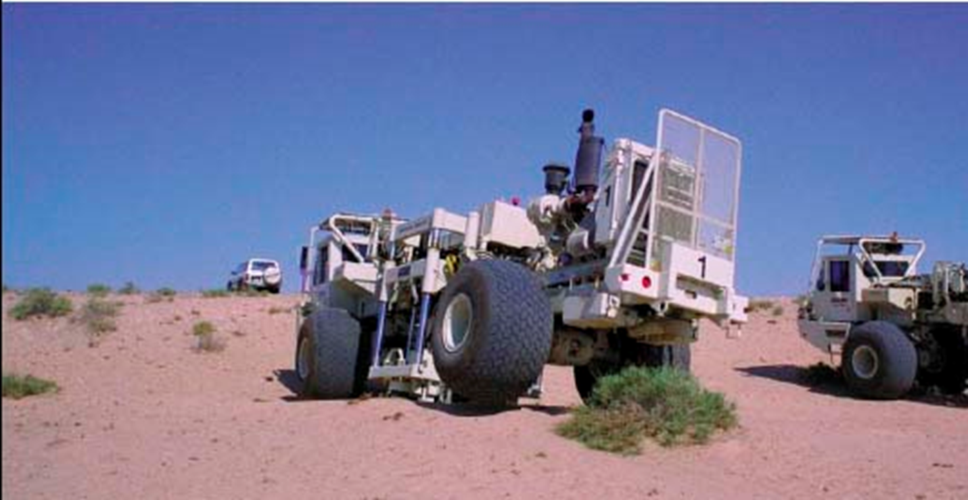
Exploration Geophysics

Slide 14

Seismic Technology

Slide 15
Seismic Technology

Slide 16
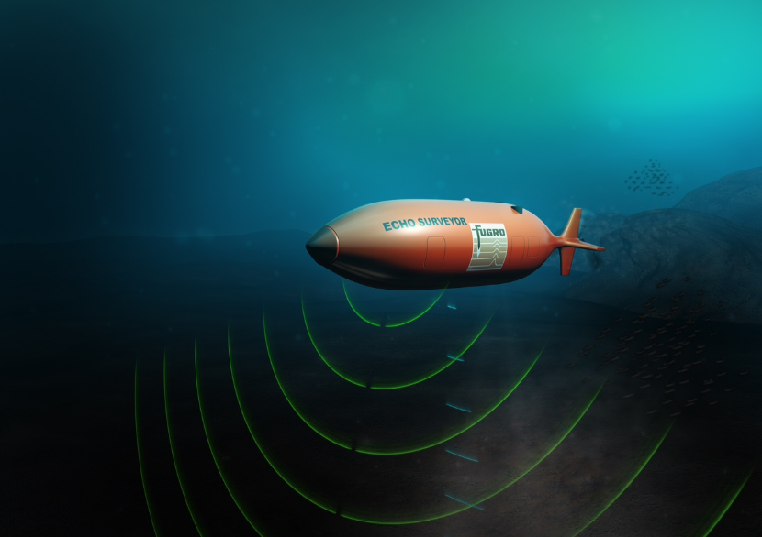
Autonomous Underwater Vehicle (AUV),

Slide 17
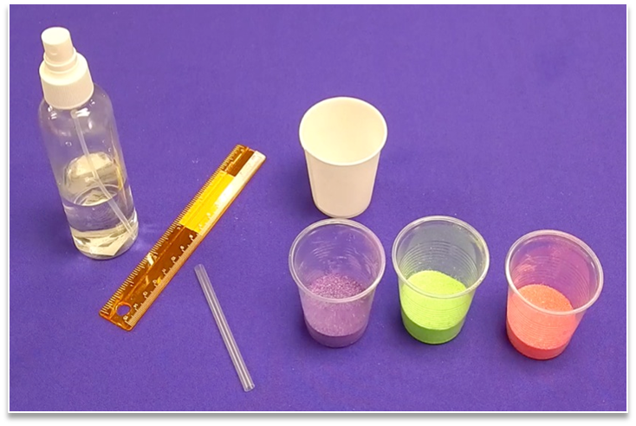
Activity: Core Sampling
Objective: Explain how geologists study the formation of rocks and sediments when searching for oil and gas.

Slide 18
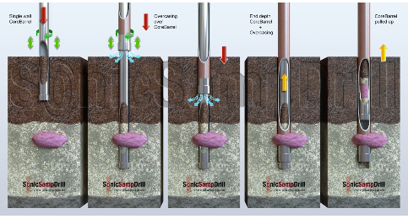
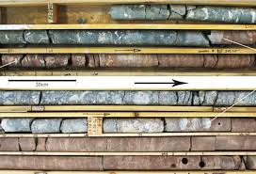
Activity: Core Sampling
Core samples are small portions of a formation taken from an existing well and used for geologic analysis.
The sample is analyzed to determine porosity, permeability, fluid content, geologic age, and probable productivity of oil from the site.

Slide 19
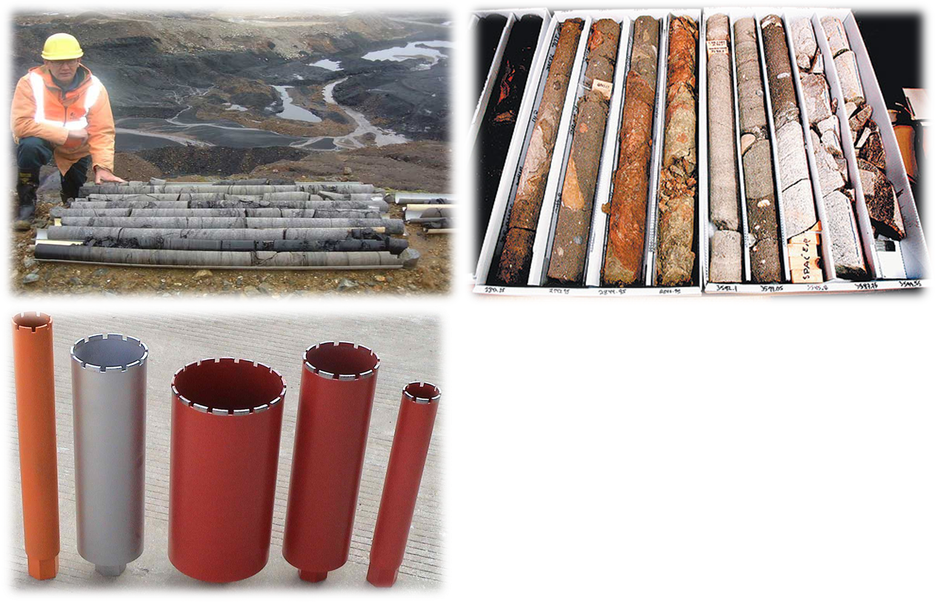
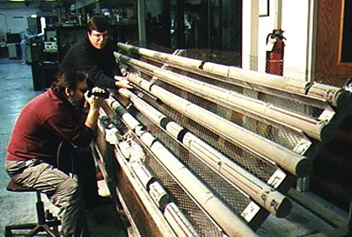
Activity: Core Sampling

Slide 20
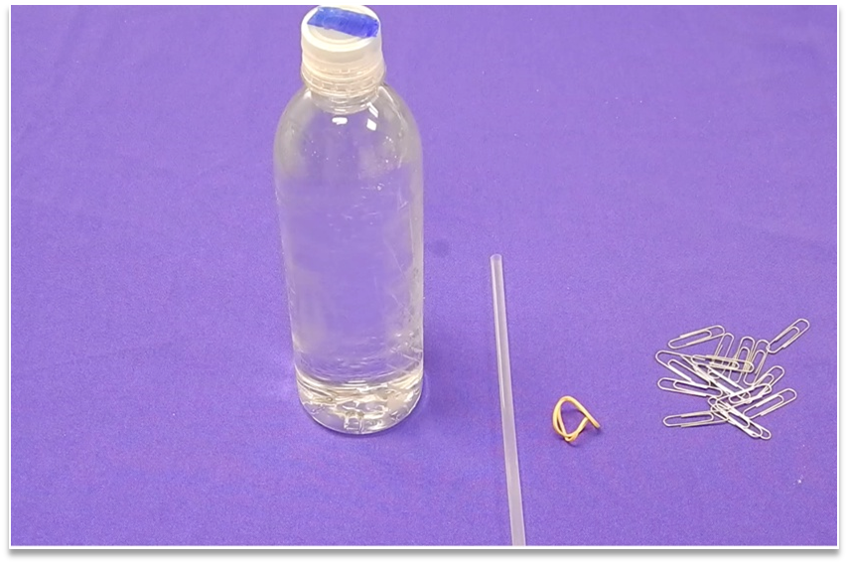
Activity: Cartesian Diver
Objective: Understand how pressure and density work in reservoirs and oil and gas separation.

Slide 21
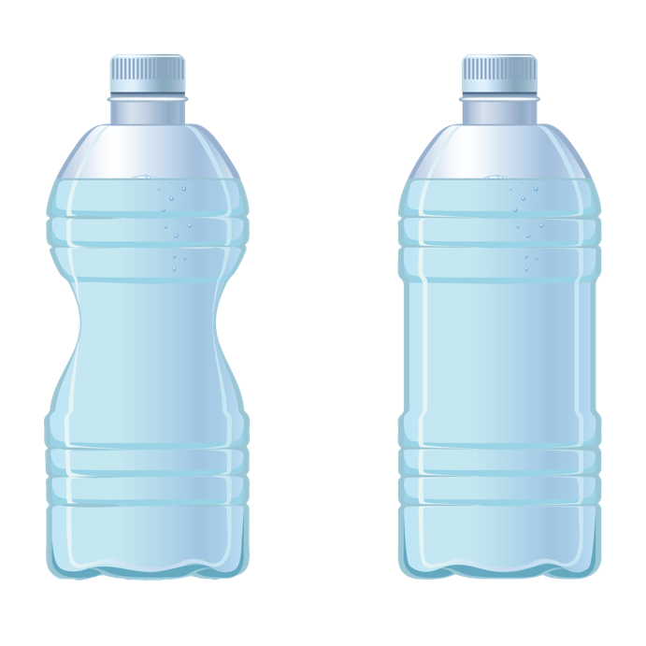


Activity: Cartesian Diver
Oil and gas separation technology makes use of density and buoyancy properties of materials. As the pressure declines in a reservoir, a gas cap is created.
This activity demonstrates that compressing material increases the material’s density.
Increasing the density then
causes the “diver” to sink when
it becomes more dense than the surrounding water. Releasing the pressure then causes the diver to float again.
Air will compress when squeezed hard
Air will expand when not squeezed
SURFACE
SINK
Small Buoyancy
Large Buoyancy

Slide 22
Activity: Porosity
Objective: Demonstrate the properties of rock necessary for a productive oil or gas well.

Slide 23
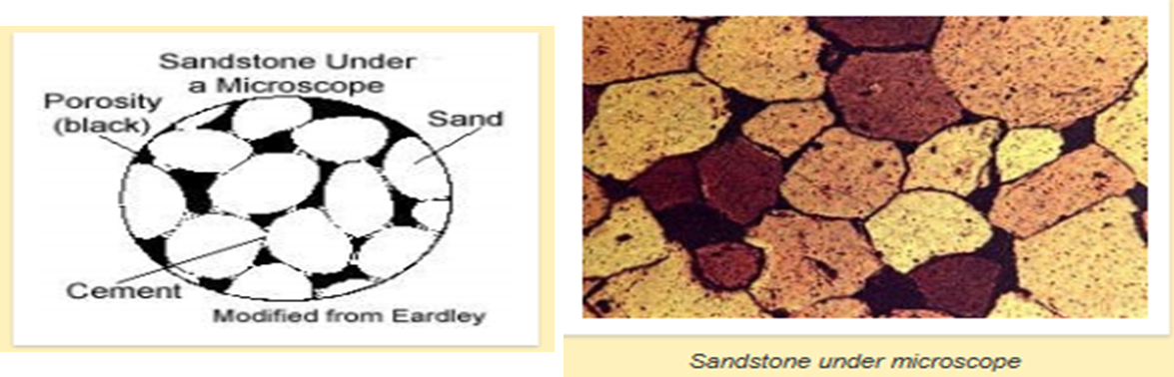
Activity: Porosity
Porosity is a measure of how much of a rock is open space. This space can be between grains or within cracks or cavities of the rock. Permeability is a measure of the ease with which a fluid (oil in this case) can move through a porous rock.

Slide 24
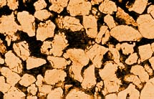
non-connected
porosity
connected porosity
(permeability)
Microscopic view of reservoir rock
“Permeability is the connected porosity. It defines the ease with which petroleum moves from one pore to another and is determined by the size of the openings that connect the pores.”
Notes:
Permeability is the measure of the connected pores. Click It is highly dependent on the size of the openings of the connected pores, the throat of the pores. You can think of a bottleneck to better understand permeability.
Of course, porosity by itself is useless, permeability by itself is useless too. You need both. Like the traffic on The Bahrain-Saudi causeway. There are a lot of lanes to service users, but you get to that point in the middle where there's only 1 or 2 lanes operating and that creates the jam. Think of the huge number of lanes as your high porosity and the two lanes causing traffic as your low permeability.

Slide 25
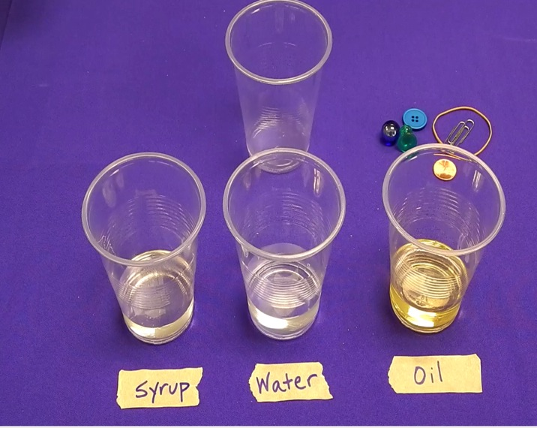
Activity: Density
Objective: Demonstrate how oil, gas, and water behave in a reservoir.

Slide 26
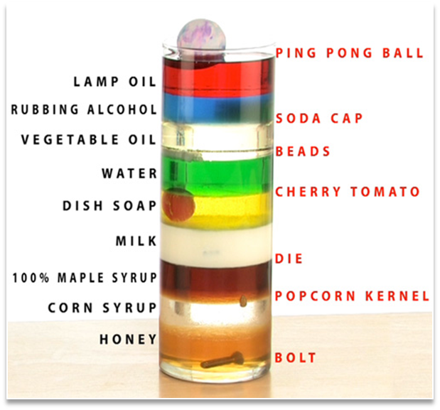
Activity: Density
Density is an important property in the formation of an oil and gas reservoir. Most reservoir rocks are porous and saturated with groundwater before oil or gas enters the rock.
Because groundwater is more dense, oil and gas is able to rise upward through the rock. The oil and gas continues to rise until trapped against an impermeable rock, or rock with spaces too small to move through, which creates a reservoir.
These reservoirs are then discovered by geologists and petroleum engineers and researched for production of the energy source.

Slide 27
Activity: Perforated Well Casing
Objective: Demonstrate the differences in production of perforated and non-perforated well casing.

Slide 28
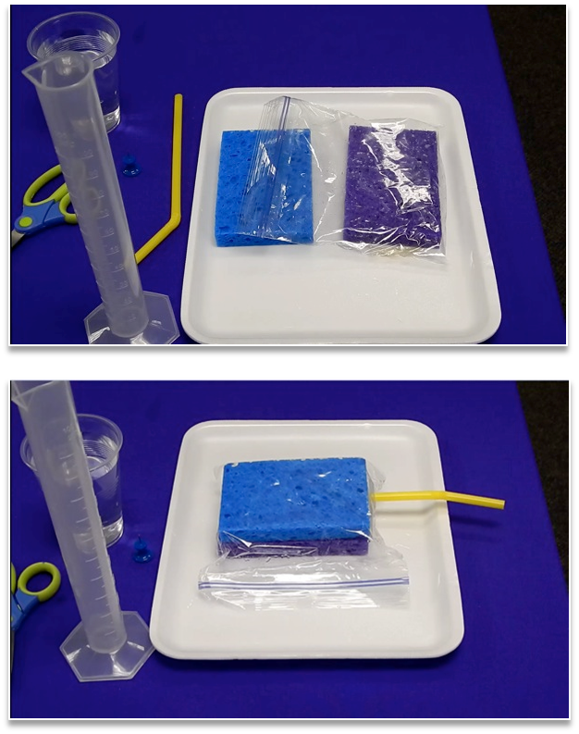
Activity: Perforated Well Casing

Slide 29
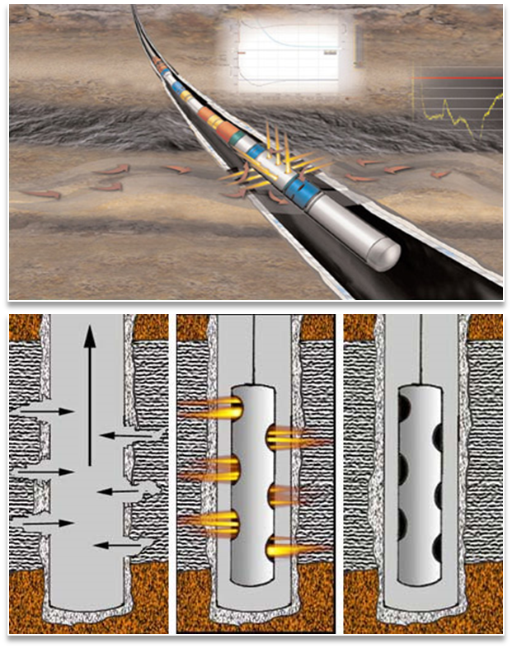
Activity: Perforated Well Casing
Petroleum engineers and geologists have developed technology to increase exposure of an oil and gas reservoir by drilling horizontally or at an angle. This method of drilling can produce three to five times more oil and gas than vertical drilling.
Perforation refers to a hole punched in the casing, or liner, of an oil well to connect it to a reservoir of oil & gas.
These holes in the horizontal well casing allow oil and gas to flow easily into the wellbore, increasing production of a reservoir.

Slide 30
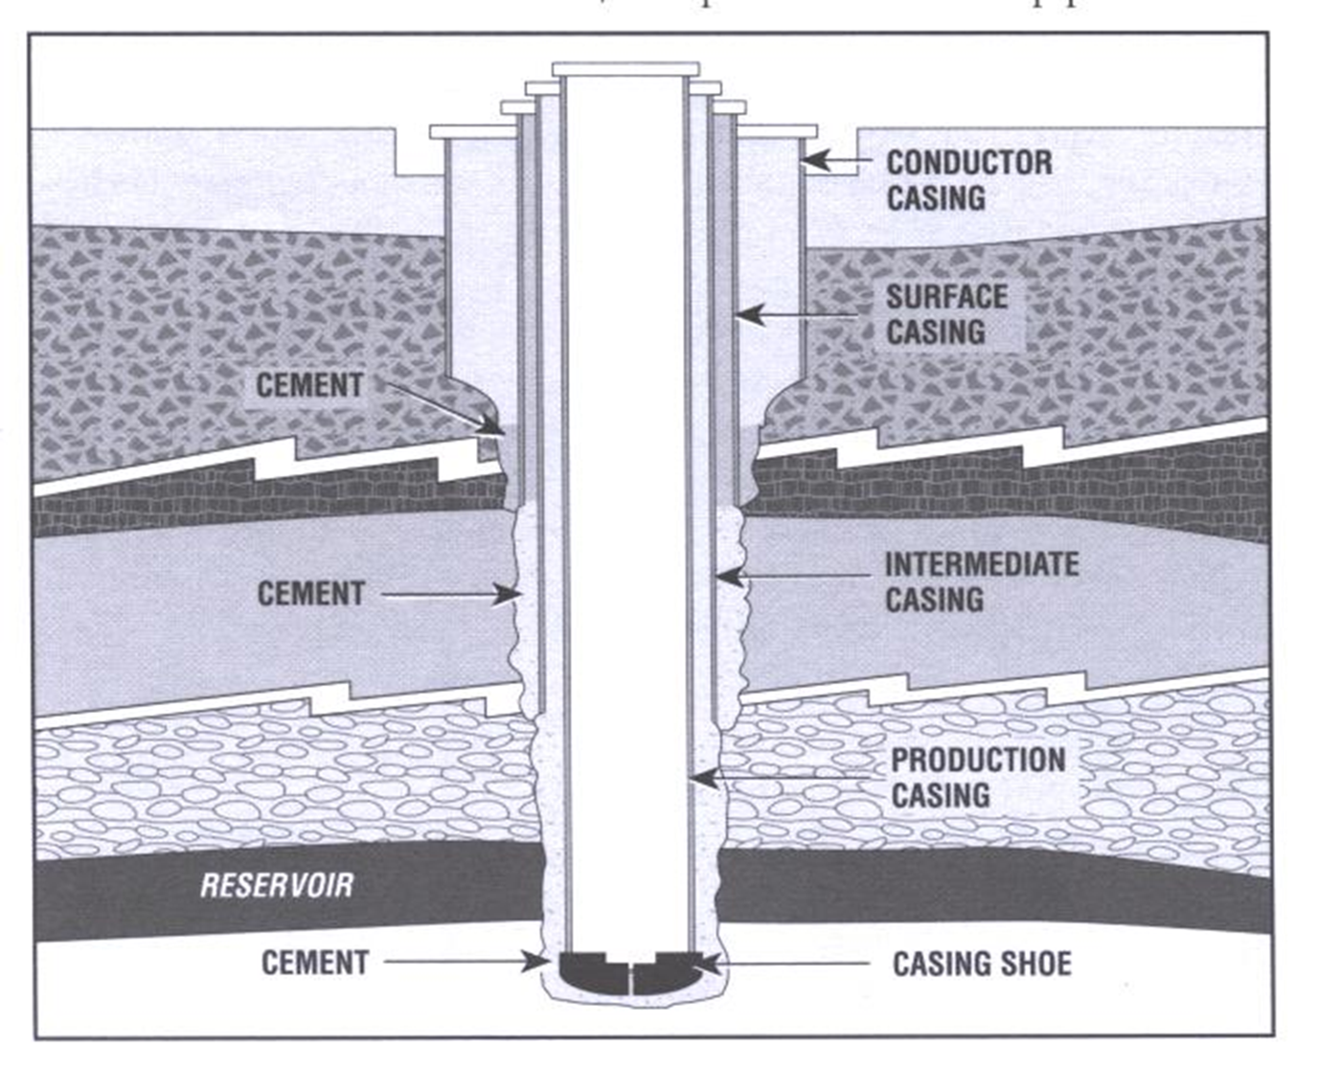
Activity: Perforated Well Casing

Slide 31
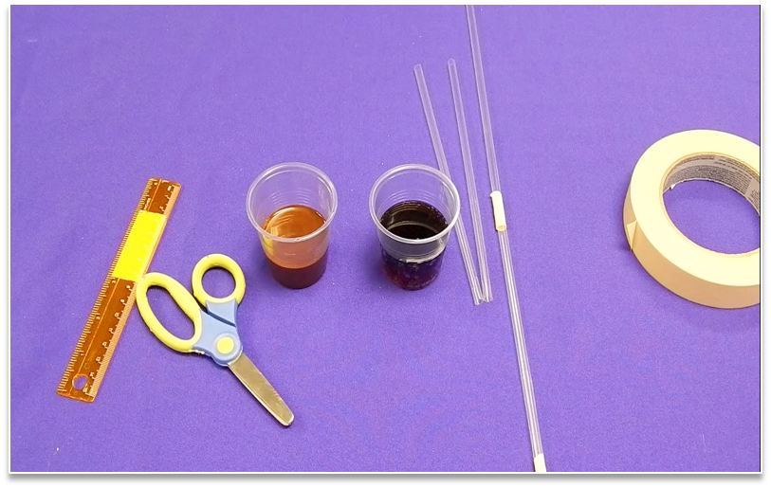
Activity: Getting the Oil Out
Objective: Model how engineers create technology to lift oil out of the ground.

Slide 32
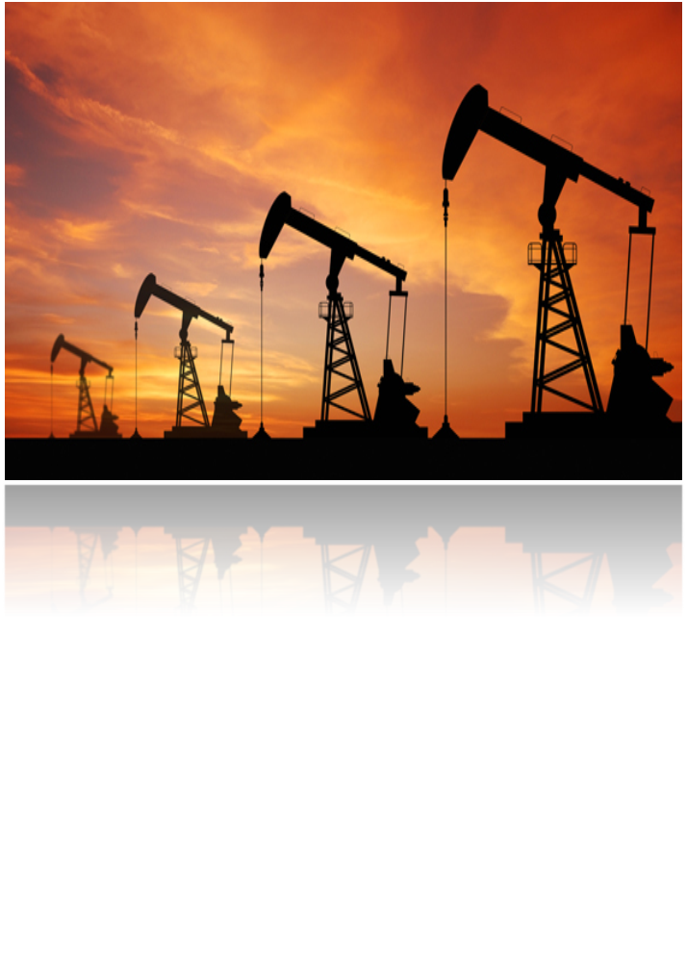
Activity: Getting the Oil Out
Oil, natural gas and saltwater are under extreme pressure below the surface trapped in reservoir rock.
These materials can flow up a well with or without assistance, depending on the properties of the well.

Slide 33

Stay connected!
Energy4me shares energy education news, blogs, workshop opportunities, and resources for teachers year round. Follow us!

