Slide 1
Energy4me Virtual
Member Training for Section

Slide 2
Agenda
Fill in based on your workshop or outreach

Slide 3
Energy4me (www.energy4me.org)
EDUCATE
teachers about the energy industry and to equip them with the resources needed to educate students.
ENGAGE
with science teachers about the benefits of using hands on activities to teach scientific concepts.
CONNECT
teachers to the industry by showcasing the role the industry plays in supplying energy demands
WORK
with local oil & gas professionals to volunteer as energy4me ambassador

Slide 4

How Oil is Produced
100 million barrels!
Chris Del Campo

Slide 5
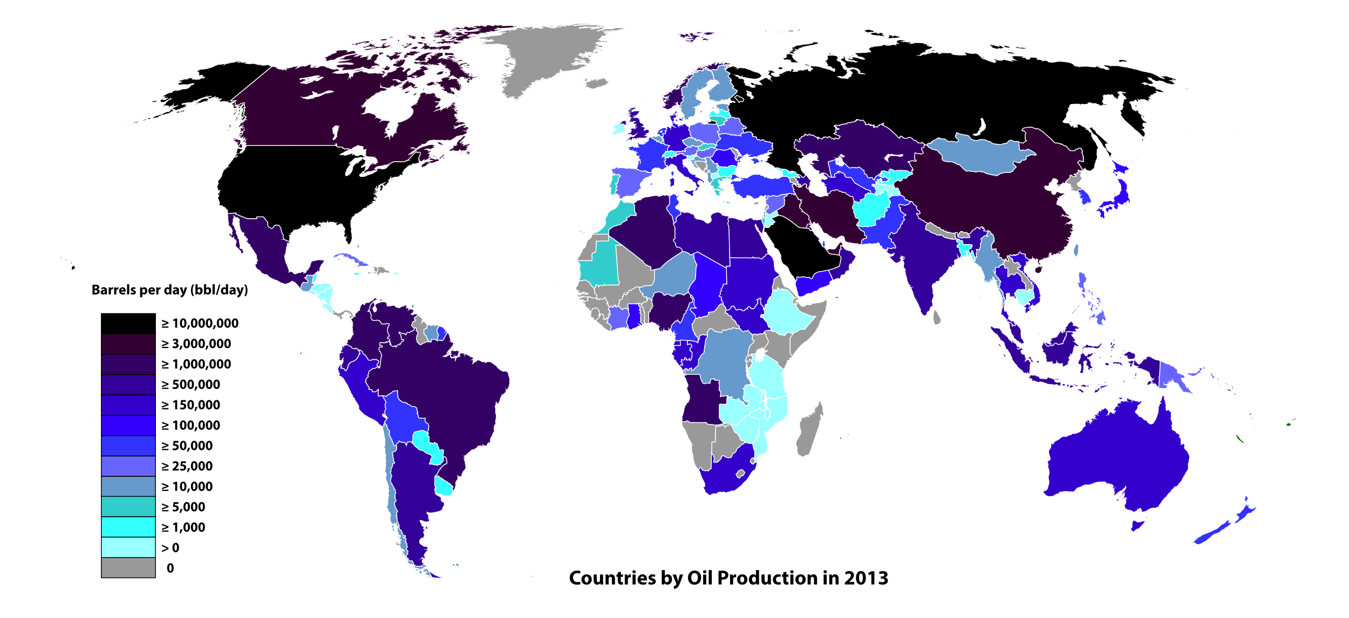
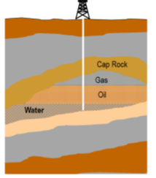
What We Need to Know
Where is the oil & gas?
Latitude and longitude
Depth
By Ali Zifan - Own work; Used a blank map from here., CC0, https://commons.wikimedia.org/w/index.php?curid=43475696

Slide 6
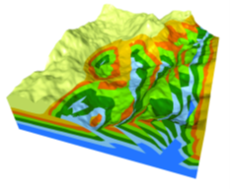
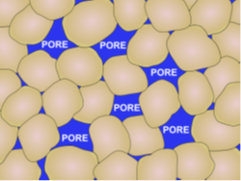
What we want to know
How much is down there?
Reservoir size (area and thickness)
Porosity
Fluid type (oil, water, gas)

Slide 7
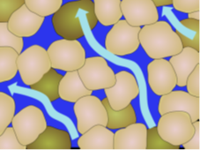


What we want to know
How difficult will it be to retrieve?
Pressure
Permeability
Viscosity

Slide 8
Energy Transition

Slide 9




What is Energy Transition?
A significant structural change in an energy system. Historically, these changes have been driven by the demand for and availability of different fuels.
.
Previous transitions
Notes:
Fire cooking and heating
Animal traction to human muscle strength for ploughing
Coal replaced wood, human and animal muscle power as a source of energy
Oil and gas with electricity: Combustion engine, lighting, mass consumption, mobility of people and goods
Energy transitions are no simple flip of a new switch following the discovery or adoption of technology. For instance, for about 25 years after 1890, America’s roadways were a wild laboratory of various conveyances. From the horse-drawn buggy to the bicycle, from the Stanley Steamer to the Model T, devices serving the same purpose – including the first electric cars – derived energy from different sources including coal, horsepower and gasoline.
Between 1850 and 1900, Americans mostly did that with oils and candles rendered from the fat of farm animals and whales, as well as from burning kerosene made first from coal and then petroleum. By the early 1900s, most American lighting was powered by electricity, initially generated from burning coal. Later in the century, that power came from a mixture of coal, natural gas, hydropower and nuclear energy. Starting around 2000, the use of wind and solar energy began to climb.
The same kinds of transformations occurred with heating and manufacturing. Cheap electricity, gasoline and diesel together produced the massive amounts of power and flexibility that completely changed the human condition in the 20th century.
In the Middle Ages, the main energy sources were firewood, charcoal, animals, and human muscle power. By 1860, 93 percent of the energy expended in England and Wales came from coal. The transition was slow and much of it happened before the Industrial Revolution: Coal’s share of energy generation in England and Wales rose from 10 percent in 1560 to 35 percent in 1660 and reached 64 percent in 1760, a date that is often taken to be the start of the Industrial Revolution. Why did the transition occur when it did and why was it so slow?
The answers to these questions have four parts. First, the transition required the invention and use of new technology in almost all cases. More rapid technological change sped up the transition. Paradoxically, however, in some instances improvements in traditional technologies extended their useful lives and thus slowed down the transition. Improvements in “old-fashioned” technology were thus one reason why the transition was not faster. Second, the invention and adoption of new technology were economic decisions that responded to economic incentives, namely prices and wage rates. This is self-evident for adoption, but it was also true of invention. While there are creative aspects to invention, it should not be regarded purely as a result of flashes of genius. In many cases, the ideas behind important inventions were banal. In all cases, time and money were required to convert the idea into an apparatus or a procedure that could work reliably in a commercial setting. Research and development (R&D) was the crux of invention, and it required the allocation of resources to the activity. That was an economic decision that depended on economic incentives. If an inventor imagined that the invention would be worth using, then there was a case for allocating resources to its development; otherwise, there was not. The balance between the potential revenue from the invention and the costs of the R&D determined whether an invention would be made.

Slide 10
Current Transition
Energy transition today
The current transition to renewable energy, and perhaps other types of sustainable energy, differs as it is largely driven by a recognition that global carbon emissions must be brought to zero, and fossil fuels are non-renewable.
Does this mean we shut down oil and gas and rely 100% on renewable energy?

Slide 11
Energy Mix 2040
International Energy Agency (IEA) World Energy Outlook
Notes:
oil will be the largest energy source in 2040, making up about 28% of the global energy mix — and natural gas will be right behind it, for 25% of supply.
Coal consumption, which is decreasing in Western markets, will stay consistent with 2018 levels thanks to growing demand in Asia.
Meanwhile, renewable energy (excl. hydro) will see an impressive renaissance, with this category (which includes wind, solar, geothermal, etc.) increasing its portion in the mix by over 300% over 22 years.
Transport, industrial, residential, agriculture, commercial, medicine, entertainment, education, “social media”, etc. create an energy demand far greater than any one source can provide.
To prevent power supply interruptions, all significant power supply sources must be stable and reliable.
If power sources are periodic in short or longer time terms, a stable, quickly available power supply or reliable low-loss energy storage must be available.
Transfer of energy, in any form, must deal with losses from every aspect of production, transport, delivery and use.
No energy generation (man-made or natural) is 100% efficient.
Energy Storage is a very important discussion point.

Slide 12
How do We Get There?
Provide energy cleaner and affordable to bring people out of poverty
Net Zero 2050
Reduce emissions operations customers using product- methane (25% ) and carbon
Focus on efficiency; use what we have
Use capital for technology to serve a low carbon society
Nature based solutions for emissions that can not be stopped- reforestations
Notes:
People are anxious. People perceive lack of action. Call for an end to the industry bc they do not see actions.
Consumers have choices.
Part of the issue is that as our planet adds close to a billion people, the total amount of energy required will grow vs today. While renewables achieve exponential growth, the only way to fill the gap in world energy needs is oil and gas. Taking oil and gas out of the mix now would drastically change everyone’s w

Slide 13
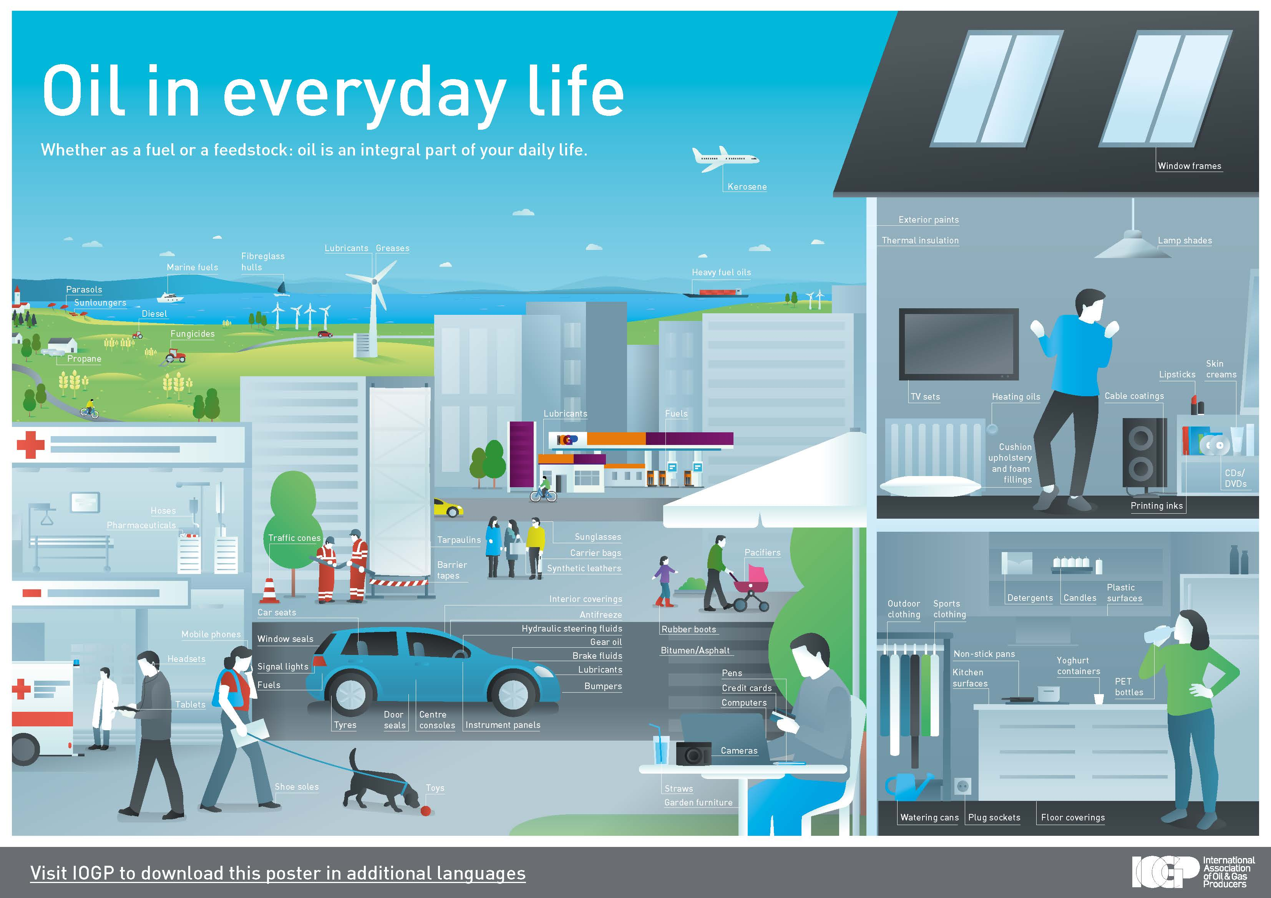
Energy Mix 2040
Notes:
Not only energy but everyday products we use…

Slide 14
Content
Local energy stats
Overview of the industry
Introduction to activities

Slide 15









Activity: Oil Seeps
Objective: Model the formation
and process of natural oil seeps

Slide 16


Activity: Oil Seeps
An oil seep is a natural leak of crude oil and gas that migrates up through the seafloor and ocean depths
Seeps occur when crude oil leaks from fractures in the seafloor or rises through seafloor sediments, in much the same way that a freshwater spring brings water to the surface
Notes:
x

Slide 17
Activity: Cartesian Diver
Objective: This activity demonstrates that compressing material increases the material’s density and its buoyancy.

Slide 18
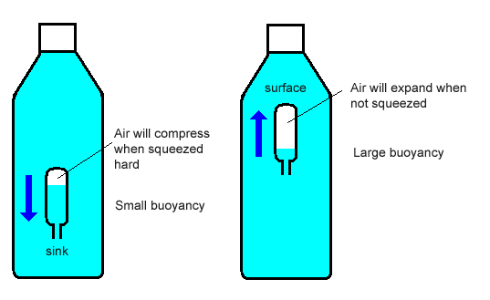
Activity: Cartesian Diver
Oil and gas separation technology makes use of density and buoyancy properties of materials. As the pressure declines in a reservoir, a gas cap is created.
Increasing the density then causes the “diver” to sink when it becomes denser than the surrounding water. Releasing the pressure then causes the diver to float again.
Notes:
is a classic science experiment which demonstrates the principle of buoyancy (Archimedes' principle) and the ideal gas law.
physical law of buoyancy, discovered by the ancient Greek mathematician and inventor Archimedes, stating that any body completely or partially submerged in a fluid (gas or liquid) at rest is acted upon by an upward, or buoyant, force, the magnitude of which is equal to the weight of the fluid displaced by the body.

Slide 19
Activity: Understanding Density
Objective: This activity explores the property of density in a variety of liquids and solids.

Slide 20
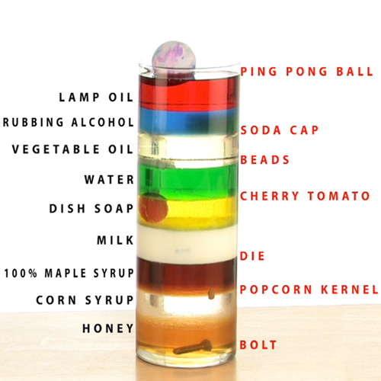
Activity: Understanding Density
Density is an important property in the formation of an oil and gas reservoir. Most reservoir rocks are porous and saturated with groundwater before oil or gas enters the rock.
Because groundwater is denser, oil and gas rises upward through the rock. The oil and gas continues to rise until trapped against an impermeable rock, or rock with spaces too small to move through, which creates a reservoir.
These reservoirs are then discovered by geologists and petroleum engineers and researched for production of the energy source.

Slide 21
Activity: Core Sampling
Objective: Explain how geologists study the formation of rocks and sediments when searching for oil and gas

Slide 22
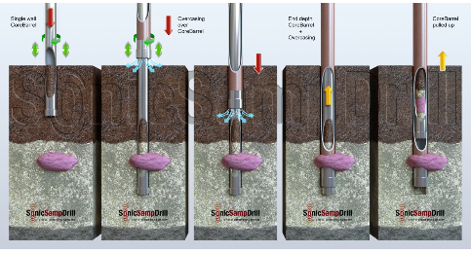
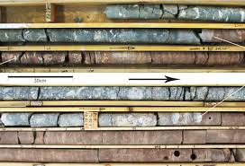
Activity: Core Sampling
Core samples are small portions of a formation taken from an existing well and used for geologic analysis.
The sample is analyzed to determine porosity, permeability, fluid content, geologic age, and probable productivity of oil from the site.

Slide 23
Activity: Getting the Oil Out
Objective: Model how engineers create technology to lift oil out of the ground

Slide 24

Activity: Getting the Oil Out
Oil, natural gas and saltwater are under extreme pressure below the surface trapped in reservoir rock.
These materials can flow up a well with or without assistance, depending on the properties of the well.

Slide 25
Activity: Perforated Well Casing
Objective: Demonstrate the differences in production of perforated and
non-perforated well casing

Slide 26
Activity: Perforated Well Casing
Petroleum engineers and geologists have developed technology to increase exposure of an oil and gas reservoir by drilling horizontally or at an angle. This method of drilling can produce three to five times more oil and gas than vertical drilling.
Perforation refers to a hole punched in the casing, or liner, of an oil well to connect it to a reservoir of oil & gas.
These holes in the horizontal well casing allow oil and gas to flow easily into the wellbore, increasing production of a reservoir.

Slide 27
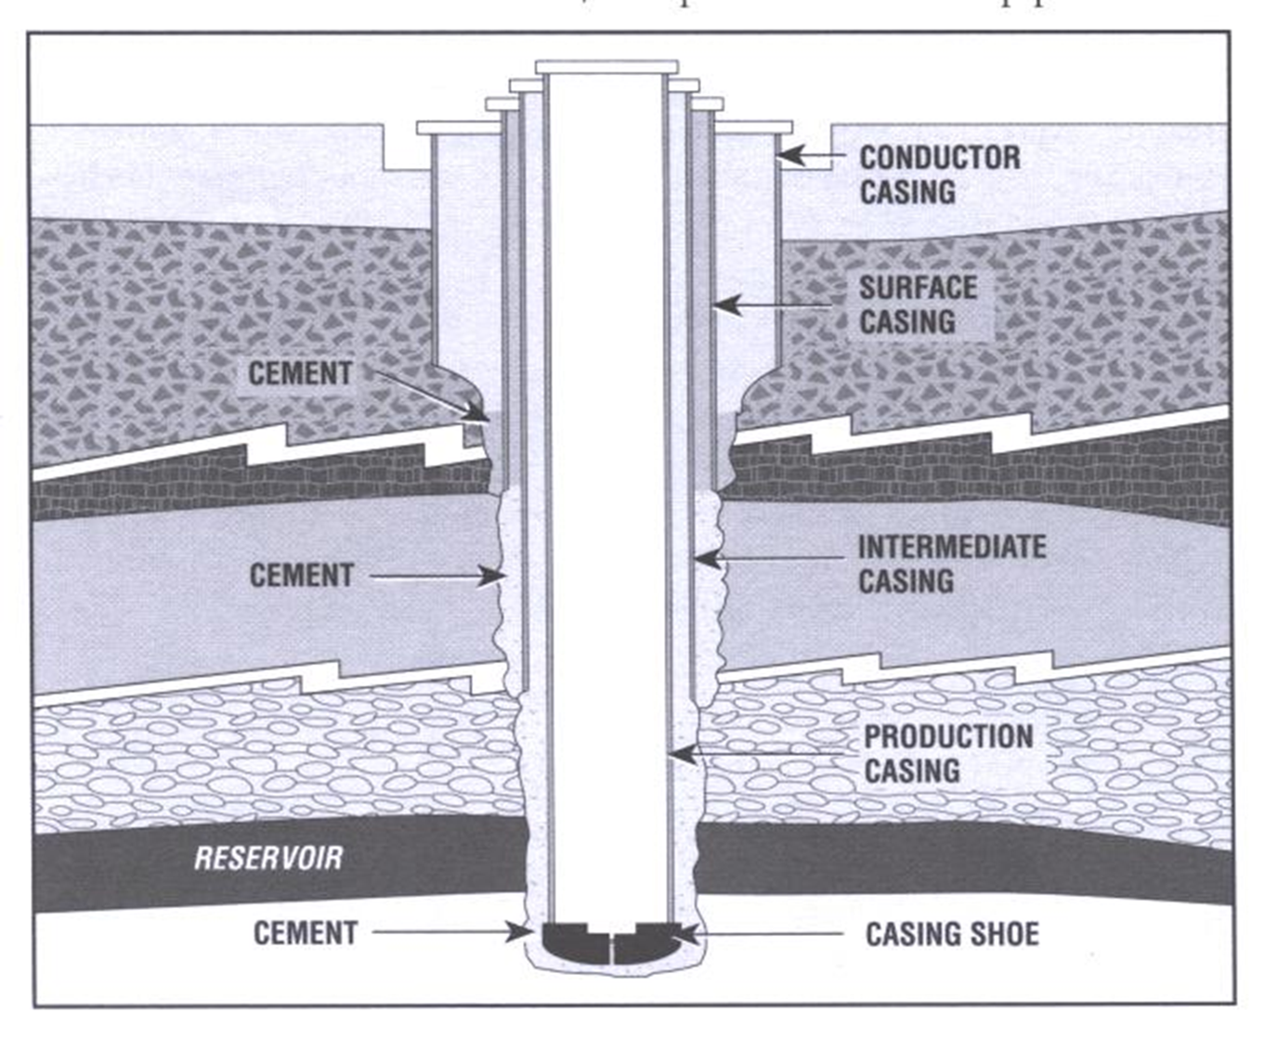
Activity: Perforated Well Casing

Slide 28
Roundup Discussion

Slide 29
www.energy4me.org

